Slide 2

Toyota Motor North America
TAGGING DECK FOR
RCT

Slide 3
TAGGING DECK REFERENCE
Version | Description | Date
Initial version(v1) | Figma Link – KBB In-Page Experience – Figma | 26 September 2025
Important Instructions
1) The same tags documented in this tagging deck are applicable for the mobile site as well

Slide 4
Business requirements
Track KBB Trade In Page Views and Tool Engagement – Slide # 4
Track Step by Step Interactions and Engagement – Slide # 4-13
Step 1 - Usage of Make & Model and VIN – Slide # 4-7
Step 2 - Vehicle Condition, Options and Ownership Info – Slide # 8-10
Step 3 - Lead Gate - Vehicle of Interest, Contact Info and Lead Submission – Slide #11-12
Step 4 - Trade In Information display, Inventory and other tools – Slide #13
Completion Rate – Key metrics used as - km-​trade-shown , km-​trade-start , km-​trade-complete
Track 90 day close rates

Slide 5

(KBB)Trade-in value modal - “Vehicle TYPE” content View and clicks
Tag(s) to fire (Metrics)
**1. aa-pageload,km-offers-search,km-qualified-action
** 2.
** 3. aa-action, km-trade-start ***
** 4. aa-action, km-trade-start ***
** 5. aa-action, km-trade-start ***
** 6. aa-action
7. aa-link
Tag(s) to Fire (Metrics) | Values to Track
All server calls listed in this slide should contain the following:
Global Block , Page Block ,Trade-In Value Block +
app_name = “kbb” content_section = “vehicle type” content_subsection = “Make & Model” or “VIN”
1. Page Block
Please see the context variables, values, and blocks above
2. Link Block
link_type_title = “header toggle” link_text = “make & model” or “vin” link_trigger = “aa-action”
3. Link Block
link_type_title = “Basic Vehicle Info” link_text = “year selected” , “make selected”, “model selected”, link_trigger = “aa-action”
4. Link Block
link_type_title = “Specific Build Info” link_text = “trim selected”, “engine selected”, “drivetrain selected” link_trigger = “aa-action”
5. Link Block
link_type_title = “Final Details” link_text = “color selected”, “mileage entered”, or “zip code entered” link_trigger = “aa-action”
6. Link Block
link_type_title = “privacy policy” link_text = “Kelley blue book privacy policy” link_trigger = “aa-action”
7. Link Block
link_type_title = “next step” link_text = “next” link_trigger = “aa-link” **** link_container = “vin used” or “no vin used”
1
3
** Only fire a tag once per CTA type, such as toggle button (2), the dropdown menu (3),(4) or textbox input (5).
*** “km-trade-start” should only fire once per modal load on the first click on
(3),(4) or (5).
**** “link_container” variable value should let us know if the vin texbox was used to return their vehicle information on tag (7).
+ “Trade-In Value Block” should capture all the applicable values from modal the into the appropriate variables.
4
5
6
7
Notes:
5

Slide 6
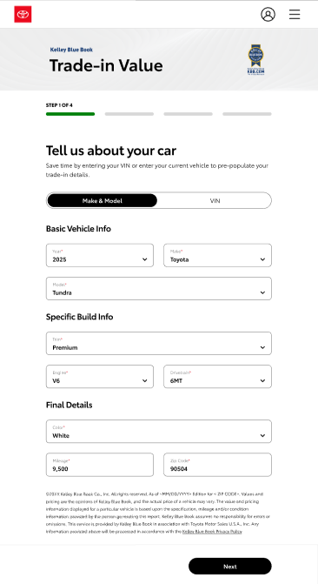
(KBB)Trade-in value modal - “Vehicle TYPE” content View and clicks
Tag(s) to fire (Metrics)
1. aa-pageload, km-​trade-shown
** 2. aa-action
** 3. aa-action, km-trade-start ***
** 4. aa-action, km-trade-start ***
** 5. aa-action, km-trade-start ***
** 6. aa-action
7. aa-link
Tag(s) to Fire (Metrics) | Values to Track
All server calls listed in this slide should contain the following:
Global Block , Page Block ,Trade-In Value Block +
app_name = “kbb” content_section = “vehicle type” content_subsection = “Make & Model” or “VIN”
1. Page Block
Please see the context variables, values, and blocks above
2. Link Block
link_type_title = “header toggle” link_text = “make & model” or “vin” link_trigger = “aa-action”
3. Link Block
link_type_title = “Basic Vehicle Info” link_text = “year selected” , “make selected”, “model selected”, link_trigger = “aa-action”
4. Link Block
link_type_title = “Specific Build Info” link_text = “trim selected”, “engine selected”, “drivetrain selected” link_trigger = “aa-action”
5. Link Block
link_type_title = “Final Details” link_text = “color selected”, “mileage entered”, or “zip code entered” link_trigger = “aa-action”
6. Link Block
link_type_title = “privacy policy” link_text = “Kelley blue book privacy policy” link_trigger = “aa-action”
7. Link Block
link_type_title = “next step” link_text = “next” link_trigger = “aa-link” **** link_container = “vin used” or “no vin used”
1
2
3
** Only fire a tag once per CTA type, such as toggle button (2), the dropdown menu (3),(4) or textbox input (5).
*** “km-trade-start” should only fire once per modal load on the first click on
(3),(4) or (5).
**** “link_container” variable value should let us know if the vin texbox was used to return their vehicle information on tag (7).
+ “Trade-In Value Block” should capture all the applicable values from modal the into the appropriate variables.
4
5
6
7
Notes:
6

Slide 7
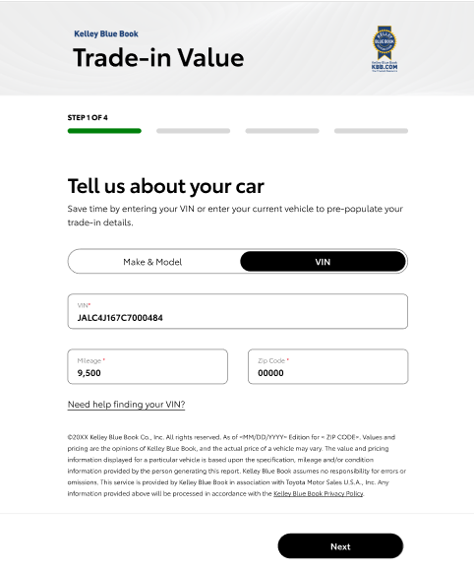
(KBB)Trade-in value modal - “Vehicle TYPE” content View and clicks
Tag(s) to fire (Metrics)
** 1. aa-action
** 2. aa-action, km-trade-start ***
** 3. aa-action
4. aa-link
Tag(s) to Fire (Metrics) | Values to Track
All server calls listed in this slide should contain the following:
Global Block , Page Block ,Trade-In Value Block +
app_name = “kbb” content_section = “vehicle type” content_subsection = “vin”
1. Link Block
link_type_title = “header toggle” link_text = “make & model” or “vin” link_trigger = “aa-action”
2. Link Block
link_type_title = “vin” link_text = “vin entered”, “mileage entered”, or “zip code entered” link_trigger = “aa-action”
3. Link Block
link_type_title = “vin” link_text = “need help finding your vin? ” link_trigger = “aa-action”
4. Link Block
link_type_title = “next step” link_text = “next” link_trigger = “aa-link” **** link_container = “vin used” or “no vin used”
** Only fire a tag once per CTA type, such as toggle button (1), textbox input (2).
*** “km-trade-start” should only fire once per modal load on the first click on (2)
+ “Trade-In Value Block” should capture all the applicable values from modal the into the appropriate variables.
**** “link_container” variable value should let us know if the vin texbox was used to return their vehicle information on tag (4).
1
2
3
4
Notes:
7

